Slide 1
PROBLEM OF OVERFITTING
Indication by :
High Variance
Low Bias
K-fold cross-validation is one of the most popular techniques commonly used to detect overfitting. We split the data points into k equally sized subsets in K-folds cross-validation, called "folds."
HOW TO DETECT OVERFITTING :

Slide 2
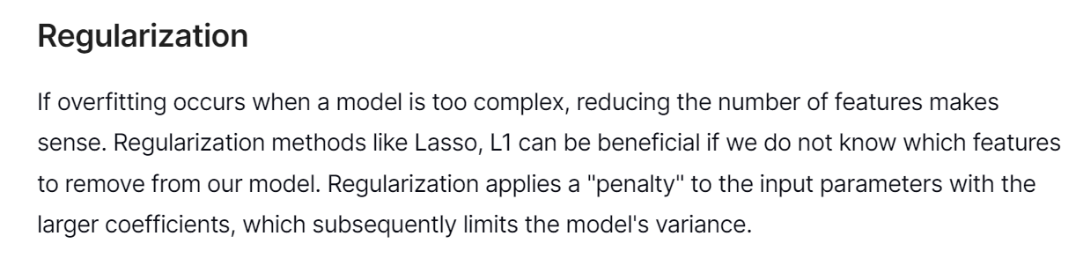
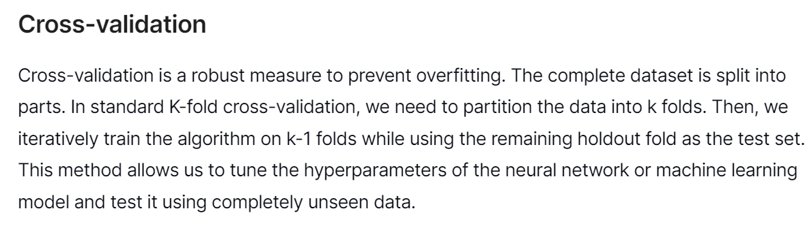
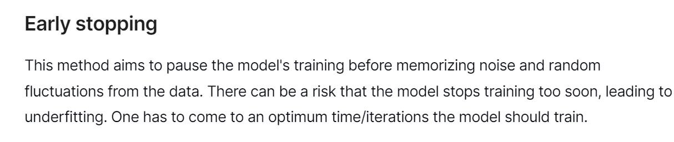
One more way : Data Augmentation (INCREASING THE DATASET)

Slide 3
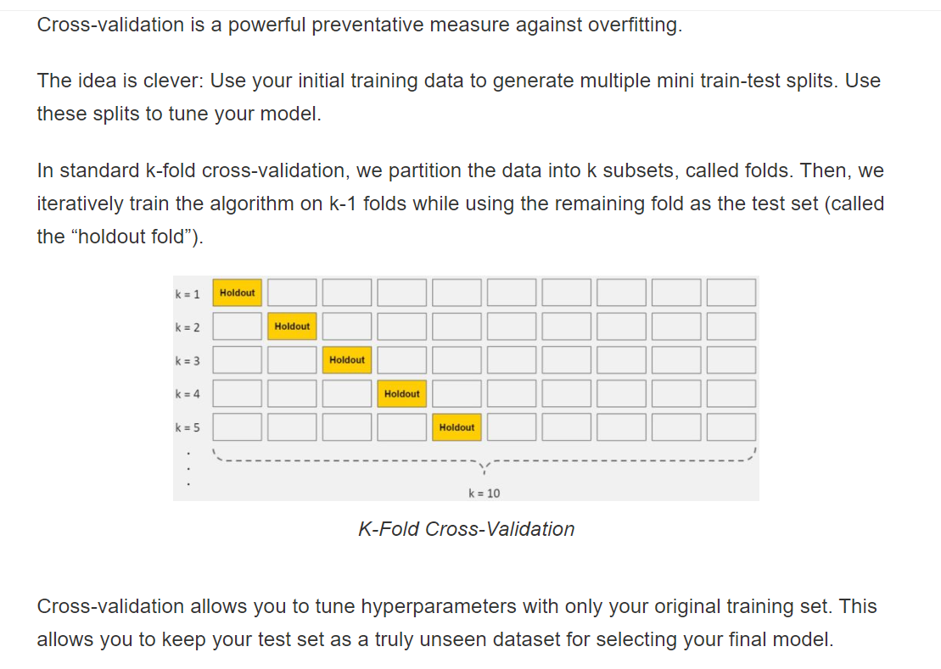

Slide 4
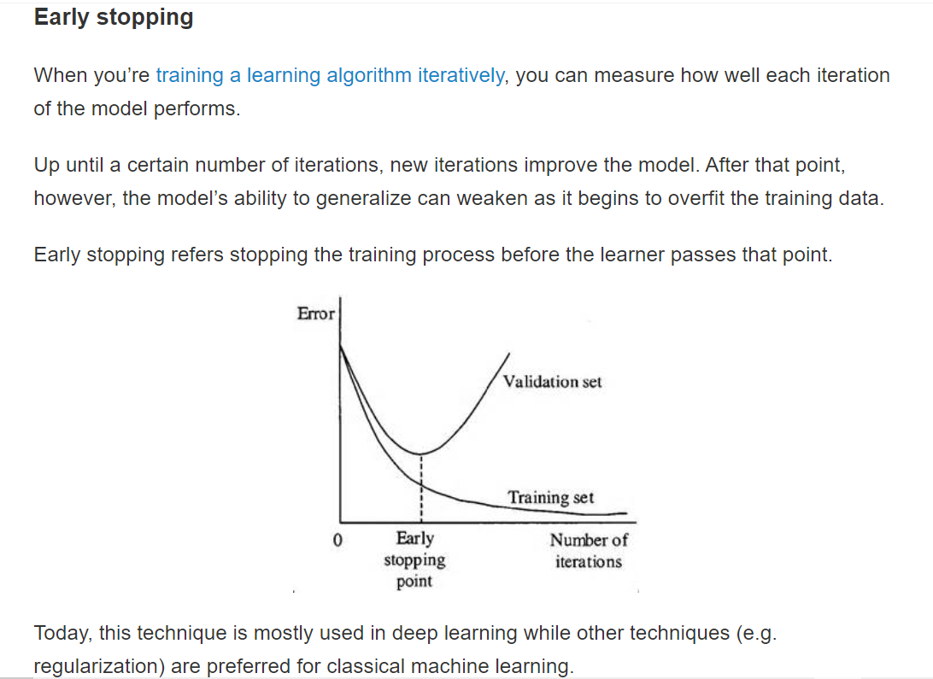

Slide 5
